Slide 1
3d-Printed Granular Jamming Hand
Melissa Indoe
Chris Kang
Sean Phelan
Maggie Serra
Chris Wallace

Slide 2
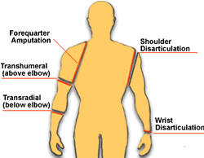
Project Background
About 12,500 new arm amputations happen every year
Most common reasons for arm amputation:
Trauma (77%)
Congenital (8.9%)
Tumor (8.2%)
Other diseases (5.8%)
Types of arm amputation:
Transcarpal (Some of the fingers)
Wrist Disarticulation
Transradial
Transhumeral
Shoulder Disarticulation
Forequarter Amputation

Slide 3
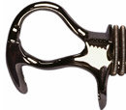
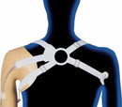
Project Background (continued)
Mechanical hands have existed for years
Run by cable attached to the shoulder
Open/closed by shrugging
Inaccurate motions
Poor ability to grasp irregularly shaped objects
Uncomfortable
Expensive
Commercially available myoelectric hands have existed for the last 5-10 years
Incredibly expensive
Heavy
2 to 3 times heavier than hook and cable
Uncomfortable

Slide 4
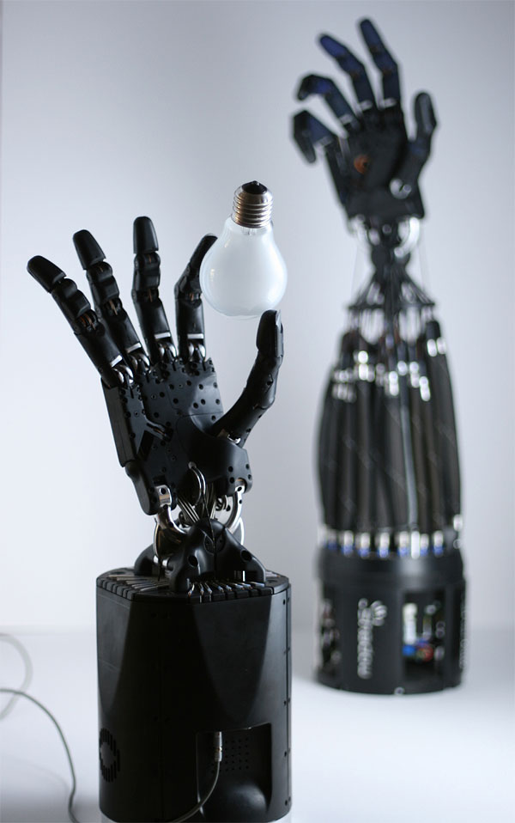
Problem Statement
Create an open-source, affordable and high functioning prosthetic hand
The hand should be task-oriented and able to achieve household activities requiring relatively low strength and high dexterity

Slide 5
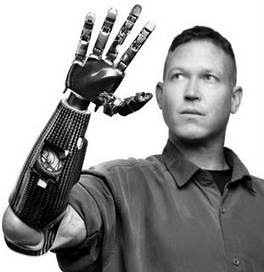
Societal Impact
Prosthetic
Able to improve quality-of-life for thousands of upper limb amputees
Affordable and approachable solution
Able to be used as hand analogs in hazardous situations
Handling of hazardous materials
Handling of babies in incubators
Manufacturing and automation
Open source
Able to be downloaded, edited and improved
by anyone, anywhere.

Slide 6
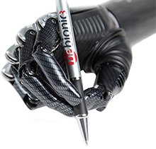
State-of-the-Art Designs
bebionic3 hand – used as human prosthesis
Individual Motors in each finger
Positioned to optimize weight distribution, making the hand feel lighter and more comfortable.
14 Selectable grip patterns and hand positions
Proportional Speed Control
precision control over delicate tasks, picks up an egg as easily as crushing an empty can.
Durable construction
strong enough to handle up to 45kg
Selectable thumb positions
Soft finger pads to enhance grip

Slide 7
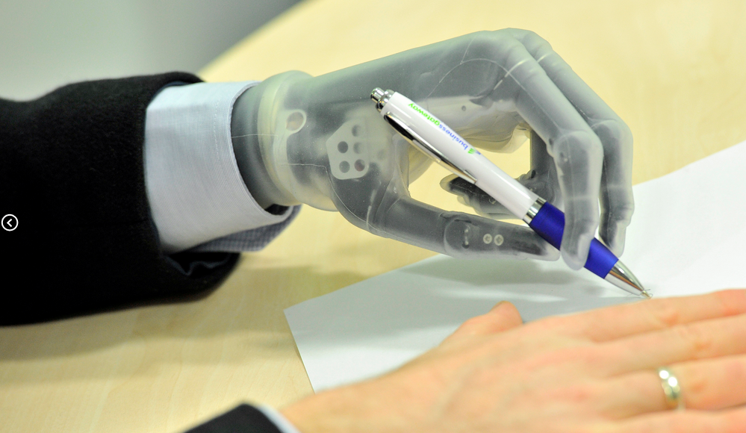
State-of-the-Art Designs
i-limb ultra revolution – used as human prosthesis
Powered rotating thumb
Five independently articulating digits with individual stall out ability. Each finger bends at the natural joints
A variety of flexible wrist options enabling more natural movement
Remote electrodes are
waterproof, low profile,
and gold-plated for higher
sensitivity
Battery powered

Slide 8
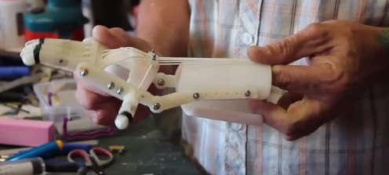
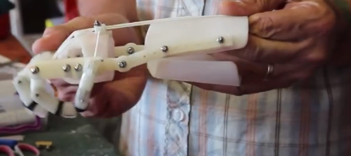
Existing Open-Source Designs
RoboHand
Completely 3D printed except for three components
Bend wrist down to close fingers
Bend wrist up to release grip
Designed for people with no fingers

Slide 9
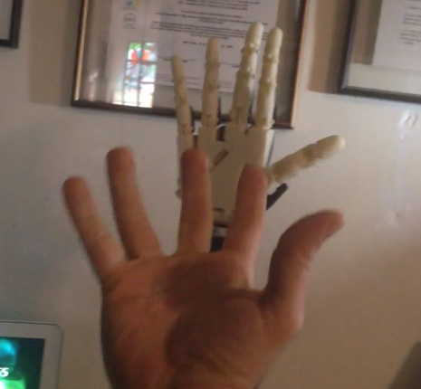
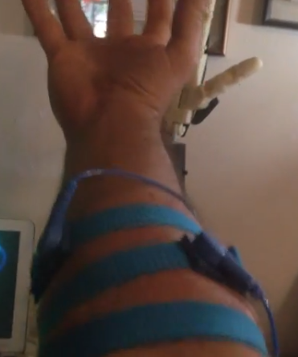
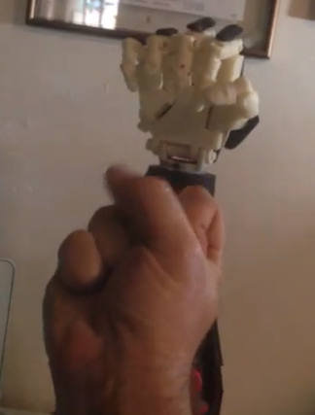
Existing Open Source Designs
InMoov
3D printed by a hobbyist
Uses motors and sensors

Slide 10
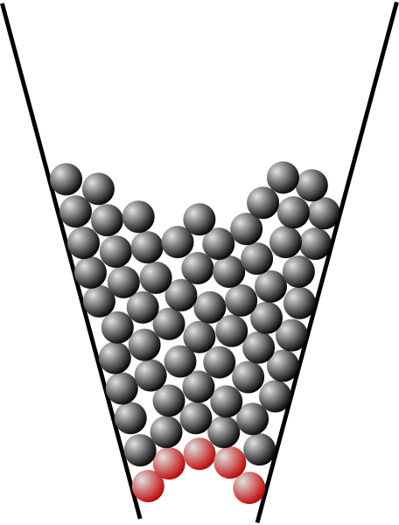
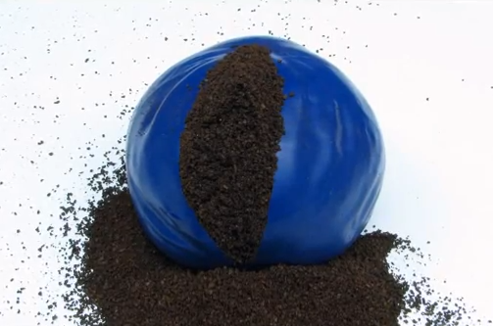
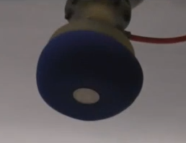
Granular Jamming
Jamming –a physical process by which some materials, such as granular materials become rigid with increasing density.
Coarse substance in a flexible casing is soft until air is removed
Example: Coffee grounds in a balloon
This can be used to pick up, grip, or throw objects
Notes:
When particles are not jammed, they are able to flow past each other. When jammed, the group of particles becomes more rigid, like how sand can be poured, but is still able to support your weight when you stand on it.
The planned design will make use of this by having pads of granular material along the palm of the hand, and then forcing the granules to jam by sucking the air out of the sac.

Slide 11
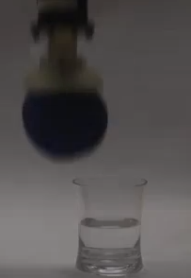
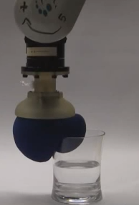
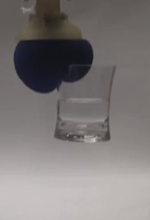
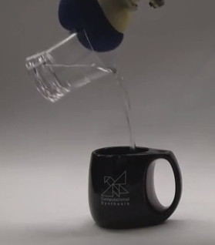
Granular Jamming In Action

Slide 12
Conceptual Designs
To simplify the design process, brainstorming was split into categories:
Category 1: Hand Ideas
Ideas relating to the rigid components of the hand
Category 2: Granular Jamming Ideas
Ideas relating to the granular jamming pads
Category 3: Other Considerations
These were ideas or requirements that did not fit into any one category

Slide 13
Hand Ideas
Joint ideas
Ways to move joints
Pneumatics
Motors (one per joint)
Cables
One cable per finger
One cable per finger, share cable for ring and pinky
One cable per joint per finger
One cable for 2 joints per finger
Motors and cables (motors at finger base)
Ideas to hold position
Gear teeth at joint interface
External joint locks

Slide 14
Hand Ideas (continued)
Straightening out the hand
Long rubber bands
Dental rubber bands
Flat springs
A second set of cables
Sensing grip
No grip sense: vacuum activated by button
Place bump sensor under granular jamming pad
Place encoder on servo motor, see if servo is stalled

Slide 15
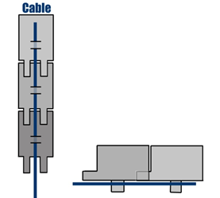
Joint Ideas Decision Matrix
Category: | Simplicity | Affordability | Size | Range of Motion | Totals:
Category Weight: | 10 | 8 | 10 | 8
Item:
Pneumatics | 2 | 4 | 3 | 6 | 130
Motors (1/joint) | 1 | 1 | 1 | 10 | 108
Cables | 9 | 9 | 9 | 7 | 308
Motors & Cables | 6 | 7 | 5 | 8 | 230

Slide 16
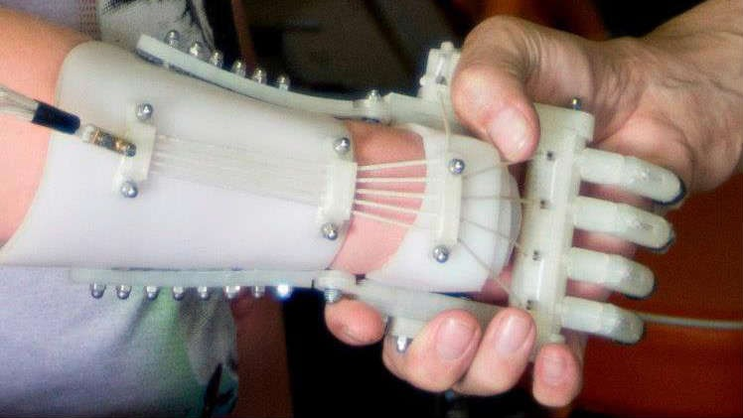
Cabling Ideas Decision Matrix
Category: | Simplicity | Affordability | Range of Motion | Totals:
Category Weight: | 10 | 8 | 8
Item:
5 Cables (1/Finger) | 9 | 9 | 7 | 218
4 Cables | 9 | 10 | 5 | 210
1 Cable/Joint | 2 | 2 | 9 | 108
1 Cable/2 Joints | 4 | 4 | 8 | 136

Slide 17
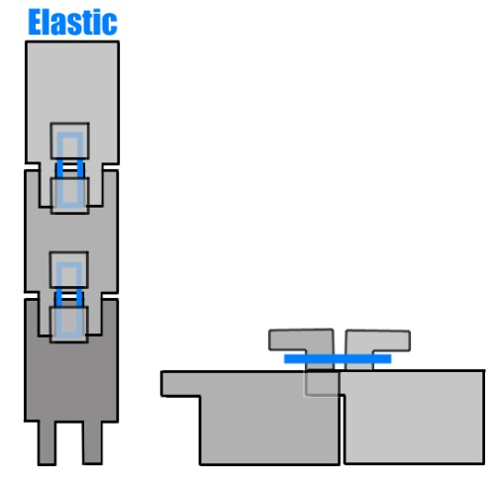
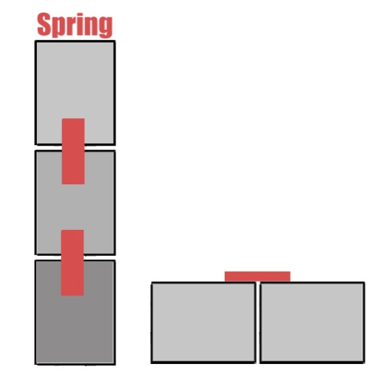
Hand Straightening Ideas Decision Matrix
Category: | Simplicity | Affordability | Reliability | Repairability | Range of Motion | Totals:
Category Weight: | 10 | 8 | 7 | 6 | 8
Item:
Long Rubber Bands | 8 | 9 | 4 | 2 | 7 | 248
Dental Rubber Bands | 6 | 9 | 5 | 9 | 7 | 277
Flat Springs | 8 | 6 | 9 | 5 | 7 | 277
Second Set of Cables | 4 | 2 | 8 | 7 | 9 | 226

Slide 18
Grip Sense Decision Matrix
Category: | Simplicity | Affordability | Reliability | Repairability | Usability | Totals:
Category Weight: | 10 | 8 | 7 | 6 | 10
Item:
Vacuum Button | 9 | 9 | 9 | 9 | 1 | 289
Bump Sensor | 4 | 4 | 3 | 2 | 10 | 205
Encoder Boards | 8 | 8 | 8 | 8 | 9 | 338

Slide 19
Granular Jamming Ideas
Granular Jamming Material
Sand
Coffee grounds
Plastic stuffing materials
Housing Material
Balloons
Silicone
Layout
Interconnected pads
Pad for fingertip
Pad for all three finger sections
Pad for only fingertip and base sections
Individual pads

Slide 20
Housing Material Decision Matrix
Category: | Simplicity | Affordability | Feasability | Totals:
Category Weight: | 10 | 8 | 9
Item:
Balloon | 8 | 10 | 7 | 223
Silicone | 9 | 9 | 8 | 234

Slide 21
Connection Method Decision Matrix
Connecting jamming pads to vacuum
Each pad has a tube to the vacuum
Pads have connections to each other
Category: | Simplicity | Affordability | Feasability | Totals:
Category Weight: | 10 | 8 | 9
Item:
Interconnected | 9 | 8 | 7 | 217
Individual | 5 | 6 | 3 | 125

Slide 22
Preliminary Testing
To see which parts of the hands were most frequently used, some simple tests were conducted
Household items were coated in chalk and then manipulated
This showed in chalk where the hand had contacted the object
Conclusion:
Mainly the fingertips and palm were used
This was then used to determine the value of individual granular jamming pads (i.e. which were most important to keep)
Other testing will also be done to determine the best granular jamming material

Slide 23
Preliminary testing (continued)

Slide 24
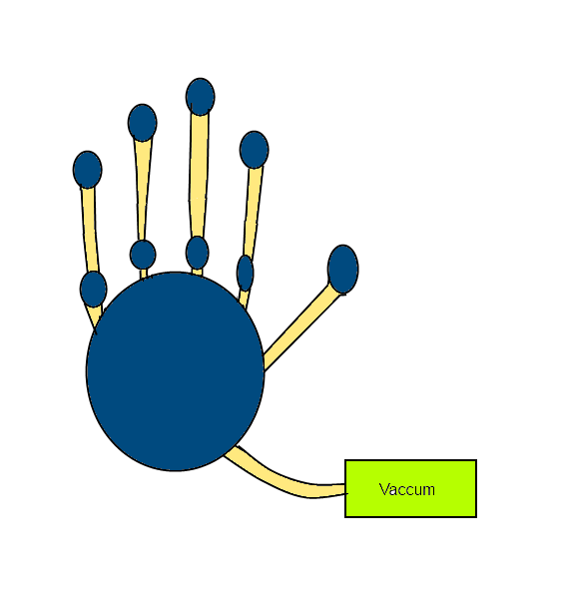
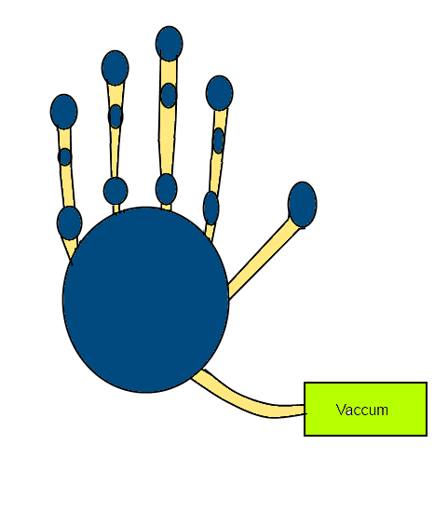
Layout Design Comparison
Layout of Granular Jamming Pads
Pad in each length
Pad in first and third length

Slide 25
Layout Decision Matrix
Category: | Simplicity | Performance | Feasability | Totals:
Category Weight: | 10 | 9 | 9
Item:
Pad for 1 | 9 | 5 | 7 | 198
Pad for 1,2,&3 | 6 | 8 | 5 | 177
Pads on 1 & 3 | 8 | 7 | 7 | 206

Slide 26
Other Considerations
Polycarbonate plastic
Making the product out of polycarbonate plastic means that it will be much stronger than most available 3d printed plastic
Use with touch screens
Conductive fabric can be added to the index finger and thumb to allow its use with smartphones
Nails
Nails are used for certain tasks (such as opening bottles)
Adding prosthetic “nails” to the project will add a little functionality
Size
Hand must follow roughly the same size of a real human hand, and cannot be much heavier

Slide 27
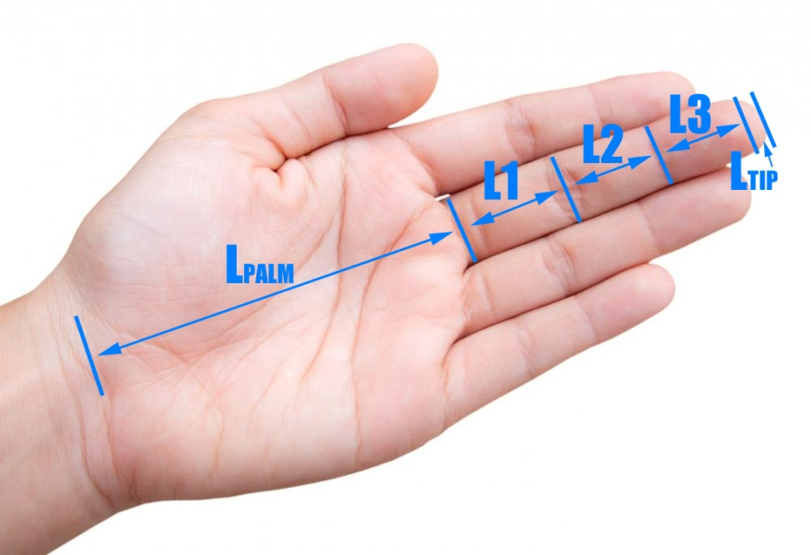
Hand Size
Important to match size of an average hand
Hand segment lengths (middle finger):
L1 = 44.6 mm
L2 = 26.3 mm
L3 = 17.4 mm
Ltip = 3.95 mm
Lpalm = 88.2 mm
Palm Width = 79 mm
Finger Width= 19.75 mm

Slide 28
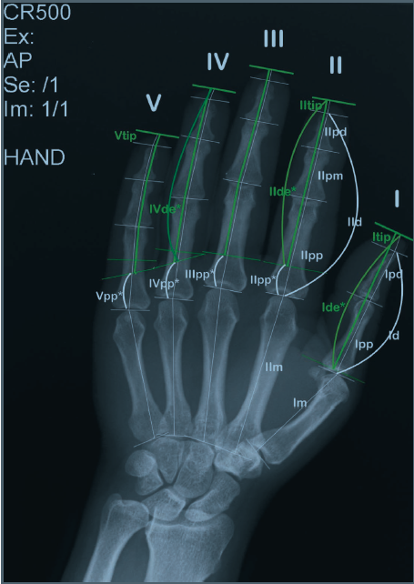
Hand size (continued)
Weight of the hand = 425.7 g
Weight of hand & forearm = 1,699.1 g
Finger length ratios:
Index = 0.8*(Middle Length)
Ring Length = 0.93*(Middle Length)
Pinky Length = 0.74*(Middle Length)

Slide 29
Conceptual Design
Primary hand design:
Run by 5 cables attached to motors in the forearm
Hand will be kept straight via dental rubber bands or flat springs
(If there is time, both will be tested)
Grip will be sensed via encoders tracking each motor
Emulate the size and weight of an average human hand
Secondary goals:
Wrist motion
Locking joints
Use with touchscreens
Accurate finger length ratios
Nails

Slide 30
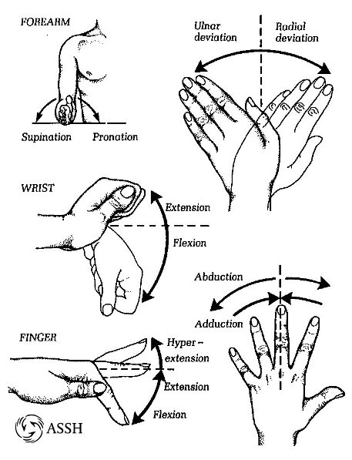
Technical Analysis
Real hand motion
3 degrees of freedom
Supination/pronation
Extension/flexion
Ulnar deviation/radial deviation

Slide 31
Technical Analysis
2 degrees of freedom
Twist and extension/flexion

Slide 32
Engineering Design
Motors for fingers
A digital I/O for signals from sensors and motors
Granular jamming pad for firm grip

Slide 33
Engineering Design
Data when moving fingers
Signals when moving wrist
Signals when grabbing objects

Slide 34
Budget

Slide 35
Deliverables at end of Semester
Gain significant knowledge in the materials and robotics field
OpenSCAD will be used to finalize design and create a complete prototype of the device in Phases II and III.
Finalized Bill of Materials
Understand and address the impact of the design in ethical, environmental, social, political, health and safety, sustainability, standardization/standards context
Complete technical analysis
Testing of designs and interfaces
Website design

Slide 36
Gantt chart

